Slide 1

SDTool STREAM project
Short guide to run the optimization and the simulations with SDTOOL
Isabella Bitetto

Slide 2
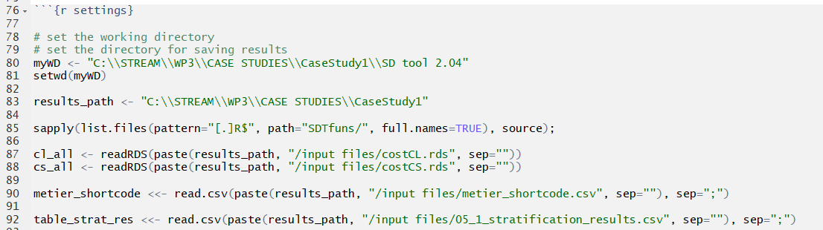
04_investigateData
Settings in the R script:
myWD: the path of the code
resuts_path:the path were will be stored the results
COST objects (CS and CL), to be stored in the input files sub-folder, in the resuts_path folder;
metier_shortcode: it is in the input folder within the SDTool. Just verify that your metier are in the list, if not, include them;
05_1_stratification_results.csv: next slide

Slide 3
04_investigateData
Settings in the R script:
05_1_stratification_results.csv
space: you an run the analysis by area putting «GSA», or by Country or you can put «ALL» to treat your samples as coming from a unique area;
time: year, quarter or semester;
technical: level 4 (gear), level 6 (metier), all together (NONE);
NO_TRIPS_4_BOOSTRAP: put 0.
Then, run the code. Pay attention that in the dedicated folder of exploratory analysis is created the file Past_situation.csv. You need for the next steps.

Slide 4
05_1_runOptimizationBYspecies
Settings in the R script:
myWD: the path of the code
CASE_STUDY_PATH: the path were will be stored the results
COST objects (CS and CL), to be stored in the input files sub-folder, in the resuts_path folder;
PastSituation: path of the file Past_situation.csv produced in the previous step.
metier_shortcode: it is in the input folder within the SDTool. Just verify that your metier are in the list, if not, include them;
05_1_stratification_results.csv: as in the previous script;
05_1_min_accepted_sample_size: the minimun number of trips considered suitable by stratum. This input constraints the script to find the solutions that are bigger or equal to the minimum you set in this file;
nIter: number of iterations for the optimization process;
REFERENCE_SPECIES= scientific name of the species (the script should be run for each species);
RS_shortcode: 3alphacode.

Slide 5
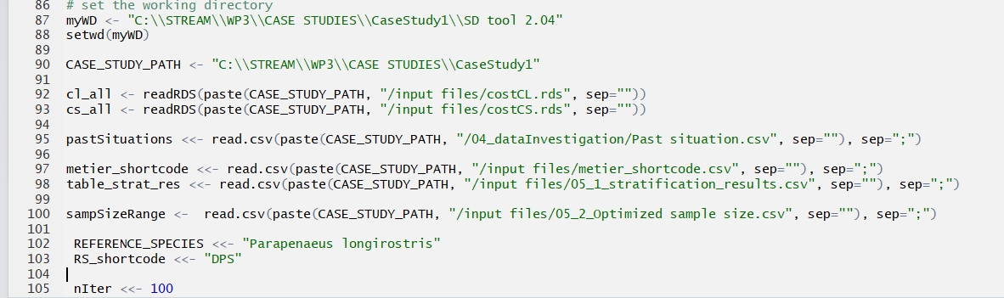
05_2_runOptimizationBySpecies
Same input of the previous script, except for:
05_2_Optimized sample size.csv.
To fill in it, open the file automatically saved by script 05_1 as species - Optimized sample size.csv, choose 2 solutions by stratum (defining the optimal range among the 4 solutions proposed) and put them in the table as min and max. Pay attention to use the same codification of the species - Optimized sample size.csv for columns Var1, Var2, Var3.
Use script utility_appendOptimizations to append the results of the different species in a unique table.

Slide 6
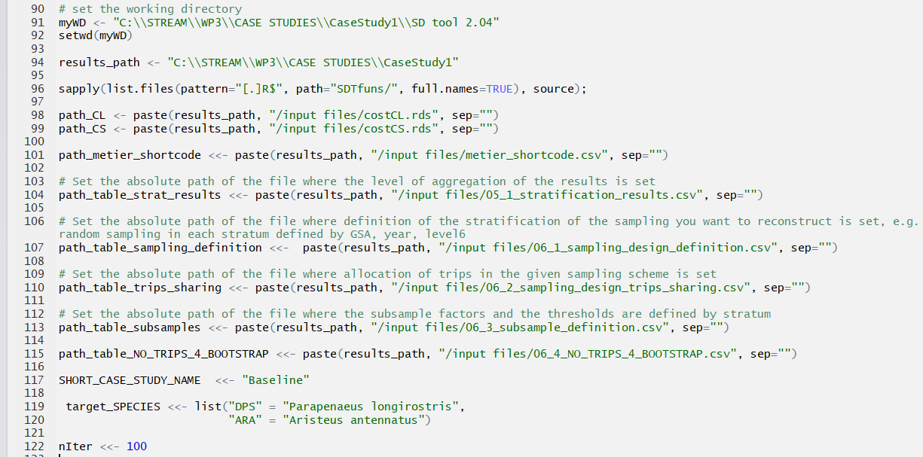
06_runScenario
Same input as the previous scripts, except:
06_1_sampling_design_definition.csv: to be compiled consistently to 05_1_stratification_results.csv (same values).

Slide 7
06_runScenario
06_2_sampling_design_trips_sharing.csv: put the number of trips to be resampled in the scenario for each defined stratum.
06_3_subsample_definition.csv: for each stratum, each species and each commercial category, put the sub-sampling factor (0.5 for a subsample of ½) and a number of individuals under which the subsampling will not be applied to the resampled trip.
06_4_NO_TRIPS_4_BOOTSTRAP.csv: compile as in the example, indicating the name of the area, the time, the techincal strata and in the last column put 0.
SHORT_CASE_STUDY_NAME: the name of your scenario.
For each scenario will be created a dedicated folder. When you will have more than one scenario, go the Evaluation.

Slide 8
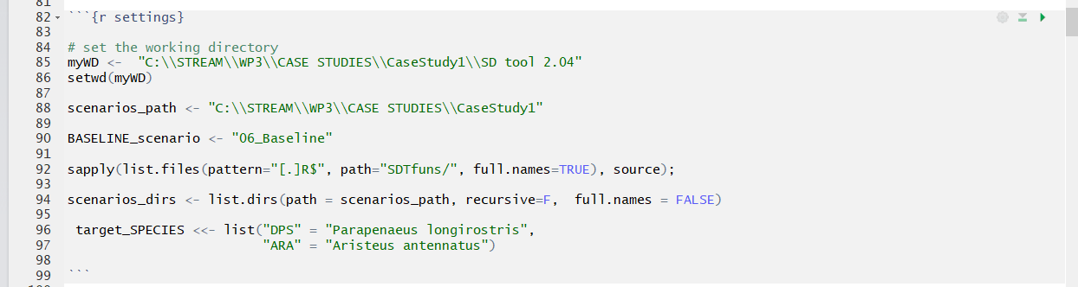
07_runEvaluation
Same input as the previous scripts, except for:
BASELINE_scenario: name of the folder containing the reference scenario.

